Slide 1
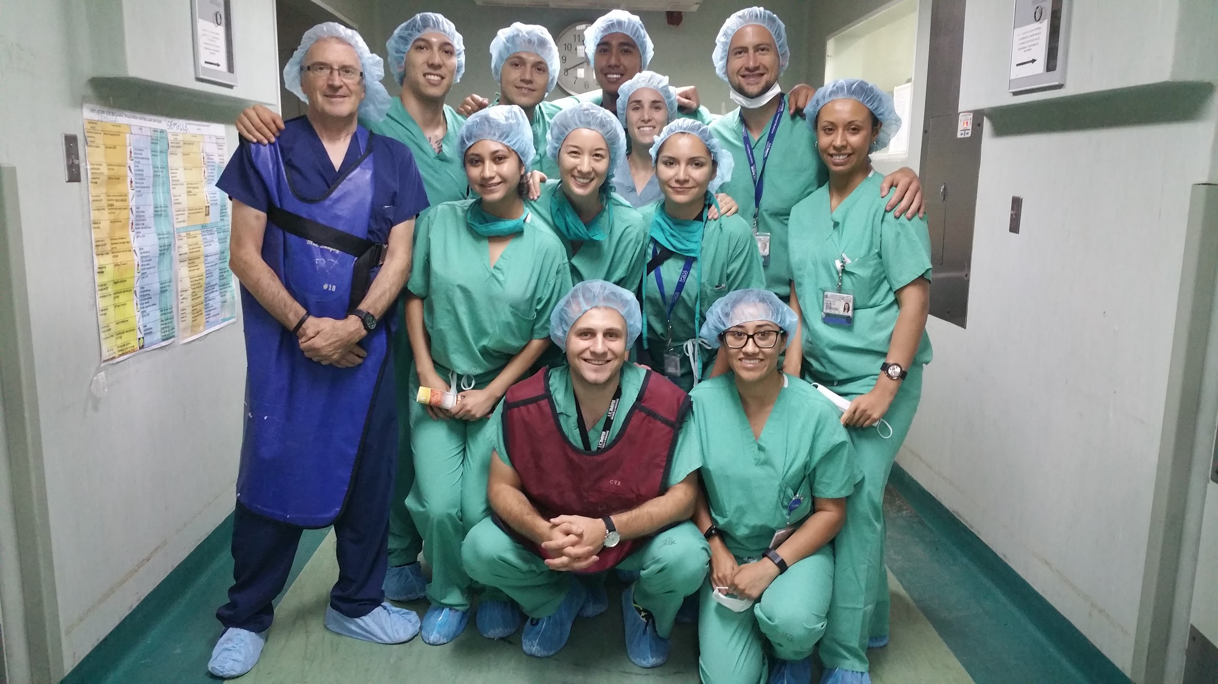
Beliefs and Treatment of Pediatric Diarrhea in Rural and Urban Nicaragua
Alison M. Uyeda, Ivan V. Shevchyk, Chris E. Silva, Molly R. Fensterwald, Christina I. Monroy, Ariana J. Martinez
Alejandra R. Gonzalez, Claribel Solorio, Shane Gillispie, Michael S. Wilkes, MD, PhD
University of California Davis, School of Medicine
Introduction:
Diarrhea remains one of the leading causes of childhood mortality, accounting for one in nine deaths in children under the age of five.¹ In Nicaragua specifically, the World Health Organization estimates that seven percent of deaths in children under the age of five is caused by diarrhea.²
Both rural and urban mothers listed hygiene, food, and microbes as the top 3 general causes of childhood diarrhea. With regard to the cause of their child’s most recent bout of diarrhea (Figure 1). Both rural and urban women most commonly cited infection, followed by food and hygiene (Figure 2). Interestingly, 10% of rural mothers listed contaminated water as a top cause of diarrhea, while only 5% of urban respondents listed water.
With regard to treatment practices, rural mothers waited an average of 2 days to seek medical attention for their child’s diarrhea, while urban mothers waited only 1.25 days (p<0.001). No significant differences were found in mother’s decisions to self-treat or seek medical treatment (p=0.573) (Table 3).
Specific Aims:
Our goal was to compare maternal beliefs about causes of childhood diarrhea and treatment preferences in rural vs. urban Nicaraguan communities to determine meaningful differences and provide a foundation to guide future health policy efforts.
Figure 4: Treatment Practices for Pediatric Diarrhea
Figure 1: Beliefs about General Causes of Pediatric Diarrhea
Experimental Design:
A 30-question cross-sectional survey was administered over three weeks to mothers in the city of Leon and rural village of Sabana Grande. A pre-qualifying interview was performed to select participants between ages 18-49 with at least one child age 5 or younger. Mothers who met the inclusion criteria were interviewed by medical students with translator assistance.
Results:
Of 132 respondents, 65.6% came from urban households and 42.4% from rural households. There were no significant differences between the age of respondents, profession, household number of kids, or average age of child with diarrhea. Urban households had a higher income than rural households overall (Table 1).
Figure 2: Beliefs about Most Recent Episode of Diarrhea
Conclusion:
Overall, we found significant differences between rural and urban Nicaraguan communities regarding both beliefs and treatment practices surrounding childhood diarrhea. Of particular interest is the discrepancy between the beliefs about water as a cause of diarrhea and the prevalence of water treatment in rural versus urban households. Further studies should be done to investigate the quality of urban and rural water in order to develop future health interventions.
Table 1: Demographic Information
Total Respondents | Rural (n = 56) | Urban (n = 76)
Age (years) | Avg = 30, SD = 7.5 | Avg = 26.6 SD = 6.4
18-28 | 42.59% | 65.8%
29-39 | 46.30% | 30.3%
40-49 | 0.07% | 3.9%
Number of Children | Avg = 2.43, SD = 1.4 | Avg = 2.1, SD = 1.2
1-3 | 80.4% | 90.8%
4-6 | 17.9% | 7.9%
> 7 | 1.8% | 1.3%
Age of Child with Diarrhea | Avg = 2.7 SD 1.3 | Avg = 2.1, SD 1.4
<1 year | 7.1% | 14.5%
1-2 | 39.3% | 53.9%
3-4 | 44.6% | 23.7%
5 | 8.93% | 7.9%
Education
None | 11% | 1.3%
Primary School | 54% | 51.3%
Secondary School | 20% | 25.0%
University | 15% | 22.4%
Profession
Homemaker | 72.7% | 71.1%
Vocational | 23.6% | 26.3%
Student | 3.6% | 2.6%
Household Size | Average = 5.3 SD=1.94 | Average=5.8 SD=2.19
1-3 | 12.5% | 9.2%
4-6 | 64.3% | 57.9%
7-9 | 21.4% | 26.3%
10+ | 1.8% | 8.9%
Household Income
≤ C$ 1000 | 41.5% | 10.3%
C$ 1001-3000 | 32.1% | 39.7%
C$ 3001-5000 | 17.0% | 29.4%
C$ 5001-7000 | 5.7% | 7.4%
≥ C$ 7001 | 3.8% | 13.2%
Ongoing Work:
We are currently working with a statistician to further analyze the influence of education, household size, and household income on beliefs and treatment practices for pediatric diarrhea.
The majority of rural mothers listed well water as their main source of drinking water, while the majority of urban mothers listed tap water as their main source (Figure 3). Rural mothers were 6.5 times more likely
to treat their water before giving it to their children (95% CI: 2.8-15.2; p<0.0001) than urban mothers (Table 2).
Table 2: Water Treatment Practices
Acknowledgements:
Funding for this project was received through a UC Davis MSRF grant. The MEDICOS Nicaragua team would like to thank Dr. Michael Wilkes for his advice and guidance throughout this project. A special thank you
Do you treat the water? | Rural | Urban
Yes | 84% | 44%
No | 16% | 56%
If yes, how? | Rural | Urban
Chemicals | 69% | 20%
Boil | 23% | 66%
Filter | 8% | 14%
to our translators, Edgar
Ochoa and Justin Lopez as well as UNAN-Leon for their logistical help in achieving this project. Additional thanks to Dr. Michael Lawson, Dr. Nate Hitzeman and Dr. Jason Auriemma for their support and mentorship.
Figure 3: Sources of Drinking Water
References:
"Global Water, Sanitation and Hygiene." Centers for Disease Control and Prevention. Centers for Disease Control and Prevention, 17 Dec. 2015. Web. 12 Feb. 2016.
Nicaragua: Country Profiles." World Health Organization. N.p., Jan. 2015. Web. 12 Feb. 2016.
Notes:
Introduction: Pediatric diarrhea remains a major concern and common cause of death in Nicaragua despite improvements in health education and sanitation. Furthermore, recent studies show that treatment for childhood diarrhea is often misaligned with evidence-based recommendations.³ 3. Colombara, DV. "Diarrhea Prevalence, Care, and Risk Factors Among Poor Children Under 5 Years of Age in Mesoamerica" National Center for Biotechnology Information. U.S. National Library of Medicine, 19 Jan. 2016. Web. 12 Feb. 2016.
Specific Aims: Our project is an exploratory study designed to generate hypotheses about the beliefs and treatment practices for childhood diarrhea in Nicaragua.
We sought to answer the following questions:
Are there different beliefs about the causes of childhood diarrhea between rural and urban communities in Nicaragua?
Are there different treatment practices for childhood diarrhea between rural and urban communities in Nicaragua?
Are there different thresholds for seeking medical care for diarrhea between rural and urban communities?

